Slide 1
Chapter 4 - Socialization
Summary of Topics
The Importance of Socialization
Socialization and Self
Agents of Socialization
Processes of Socialization

Slide 2
What is socialization??
http://www.youtube.com/watch?v=VEG2NqIuK1E

Slide 3
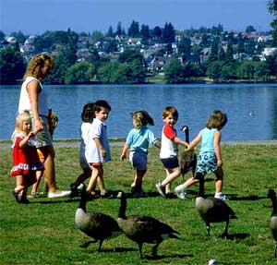
The Importance of Socialization
Socialization is the cultural process of learning to participate in group life.
Without it, we would not develop many of the characteristics we associate with being human.

Slide 4
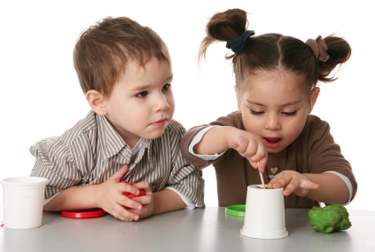
Socialization and Personality
Socialization begins at birth and continues throughout life.
Successful socialization enables people to fit into all kinds of social groups.
The most important learning occurs early in life.
Studies show that without prolonged and intensive social contact, children do not learn such basics as walking, talking, and loving.
Without socialization, a human infant cannot develop the set of attitudes, beliefs, values, and behaviors associated with being an individual.

Slide 5
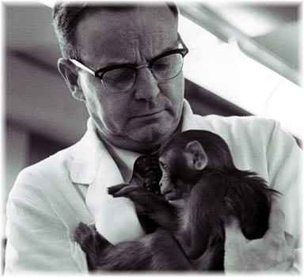
How do we know socialization is important?
Experiments and nonexperimental evidence
Psychologist Harry Harlow devised a famous experiment that showed the negative effects of social isolation on rhesus monkeys.

Slide 6
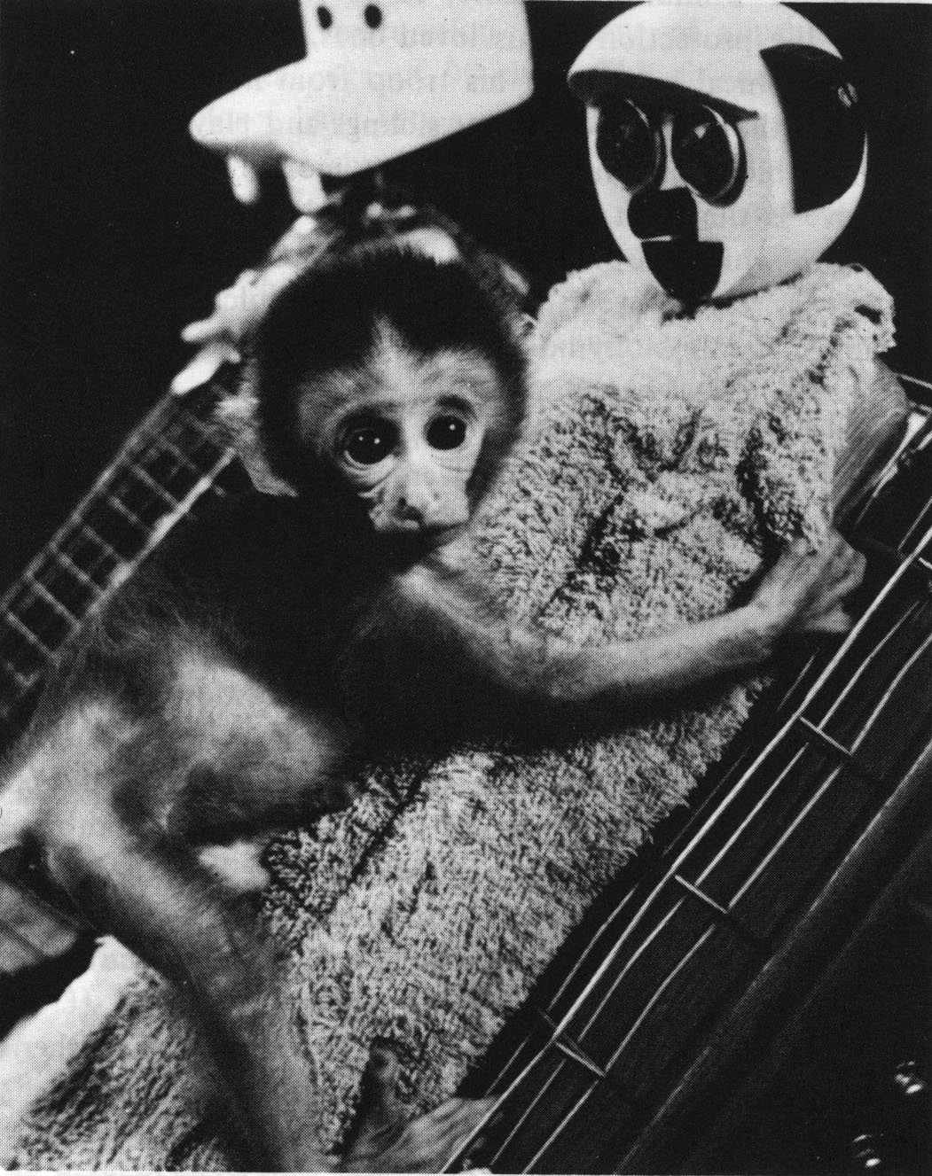
How do we know socialization is important?
Experiments and nonexperimental evidence
Harlow showed that infant monkeys need intimacy, warmth, physical contact, and comfort.

Slide 7
How do we know socialization is important?
Infant monkeys raised in isolation became distressed, apathetic, withdrawn, hostile adult animals.

Slide 8
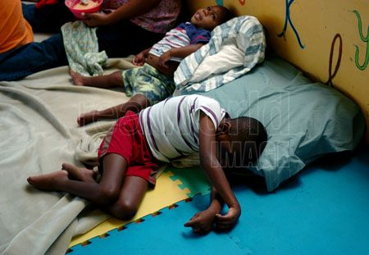
Lawrence Casler’s Study
Human babies denied close contact usually have difficulty forming emotional ties with others.
The developmental growth rate of institutionalized children who receive less physical contact than normal, can be improved with only twenty minutes of extra touching a day.

Slide 9
What can we learn from these experiments and nonexperimental evidences?
The personal and social development associated with being human is acquired through intensive and prolonged social contact with others.
Click the mouse button or press the space bar to display the answer.

Slide 10
Socialization and the Self
All three theoretical perspectives agree that socialization is needed if cultural and societal values are to be learned.
Functionalism stresses the ways in which groups work together to create a stable society.

Slide 11
Socialization and the Self
All three theoretical perspectives agree that socialization is needed if cultural and societal values are to be learned.
The conflict perspective views socialization as a way of perpetuating the status quo.
According to symbolic interactionism, the self-concept is developed by using other people as mirrors for learning about ourselves.
self-concept
looking-glass self
significant others
role taking
generalized other

Slide 12
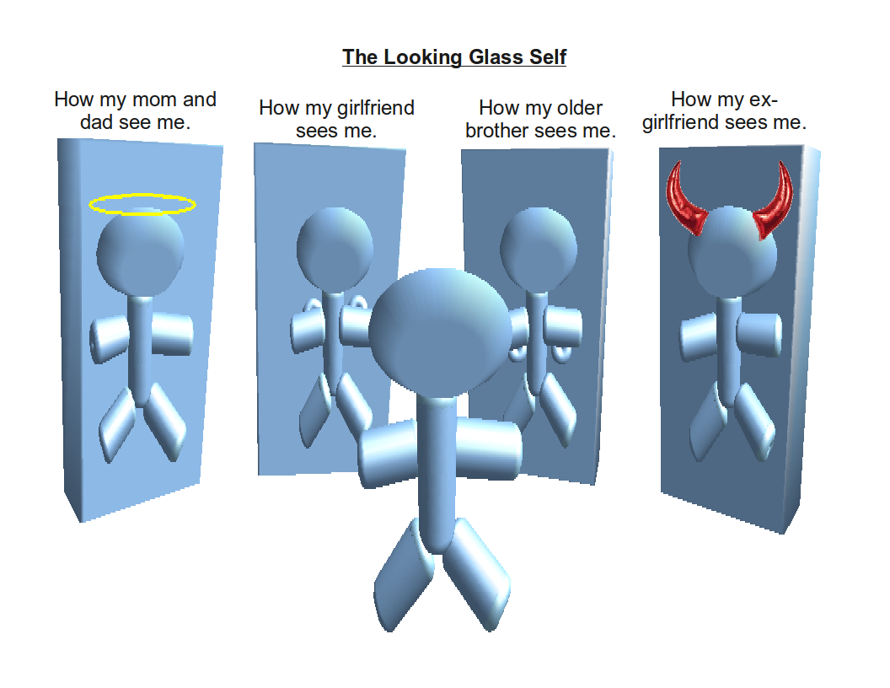

Slide 13
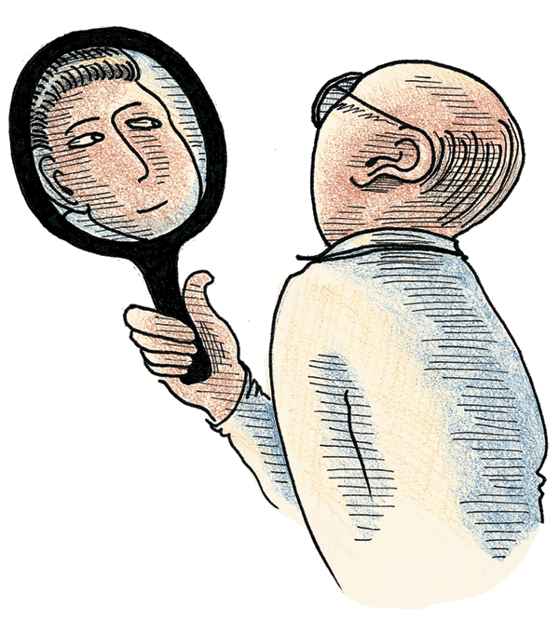
Symbolic Interactionism and Socialization
Your self-concept is your image of yourself as having an identity separate from other people.
The looking-glass self (Cooley, 1902) is an image of your self based on what you believe others think of you.
Role taking allows us to see ourselves through the eyes of someone else.
A generalized other is an integrated conception of the norms, values, and beliefs of one’s community or society.

Slide 14
How does the looking –glass process work? According to Charles Cooley
First, we imagine how we appear to others.
Next, we imagine the reaction of others to our (imagined) appearance.
Finally, we evaluate ourselves according to how we imagine others have judged us.

Slide 15
Some people’s reactions are more important to our self-concept than others. – Significant others.

Slide 16
How does the ability for role taking develop?
(According George Mead)
Imitation stage- children begin to imitate behaviors without understanding why.
Play stage children act in ways they imagine other people would.
Game stage – children anticipate the actions of others based on social rules

Slide 17
What is the looking-glass self?
The “looking-glass self” is a self-concept based on our idea of others’ judgments of us.
What are the consequences of having a distorted looking glass?
Having a distorted looking glass (incorrectly imagining others’ opinions of us) can cause bad feelings, or a negative self-image.
Click the mouse button or press the space bar to display the answer.

Slide 18
Agents of Socialization
During childhood and adolescence, the major agents of socialization are:
family
school
peer group
mass media
Click on a hyperlink to display more information about a particular agent of socialization.

Slide 19
The Family and Socialization
The family’s role is critical in forming basic values. Within the family, essential developments occur. The child learns to:
think and speak
internalize norms, beliefs, and values
form some basic attitudes
develop a capacity for intimate and personal relationships
acquire a self-image (Handel, 1990)

Slide 20
Socialization in Schools
In school, for the first time, many of the child’s relationships with other people are impersonal.
Rewards and punishments are based on performance rather than affection.
A teacher evaluates her students by more objective standards than a mother.
Children are taught to be less dependent emotionally on their parents.
The school also creates feelings of loyalty and allegiance to something beyond the family.
Underlying the formal goals of the school is the hidden curriculum.
the informed and unofficial aspects of culture that children are taught in preparation for life
Click on the hyperlink to display the definition of hidden curriculum.

Slide 21
Peer Group Socialization
A child’s peer group–composed of individuals of roughly the same age and interests–is the only agency of socialization that is not controlled primarily by adults.
Young people have an opportunity to engage in give-and-take relationships.
Children experience conflict, competition, and cooperation.
Children also gain experience in self-direction.
Peer groups give children a chance to begin to make their own decisions, experiment with new ways of thinking, feeling, and behaving.

Slide 22
The Mass Media and Socialization
Mass media are means of communication designed to reach the general population.
They include television, radio, newspapers, magazines, movies, books, the Internet, tapes, and discs.
It is often through the mass media that children are introduced to numerous aspects of their culture (Fishman and Cavender, 1998).

Slide 23
Why does the family have such strong influence on a child’s socialization?
Being in a family provides a child’s first exposure to the world, where he learns to think and speak; internalize norms, beliefs, and values; form basic attitudes; develop a capacity for intimate and personal relationships; and acquire a self-image.
Click the mouse button or press the space bar to display the answer.

Slide 24
Processes of Socialization
Symbolic interactionism views socialization as a lifelong process.
Desocialization is the process of having to give up old norms.
Resocialization begins as people adopt new norms and values.
Anticipatory socialization and reference groups are concerned with voluntary change as when moving from one life stage to another.
Click on a hyperlink to view more information on the process of socialization.

Slide 25
Desocialization
Desocialization is the process of having to give up old norms.
In institutions, replacing personal possessions with standard-issue items promotes sameness among the residents.
The use of serial numbers to identify people and the loss of privacy also contribute to the breakdown of past identity.
Cult members may even be denied use of their given names.

Slide 26
Resocialization
Resocialization begins as people adopt new norms and values.
In institutions, they attempt to give residents new self-concepts using an elaborate system of rewards and punishments.
Though developed to analyze social processes in extreme situations, the concepts of desocialization and resocialization still apply to other social settings.
Desocialization and resocialization occur as a child becomes a teenager, when young adults begin careers, and as the elderly move into retirement or widowhood.

Slide 27
Identify the following actions as desocialization (D), resocialization (R), or anticipatory socialization (A).
R
___ a. First-year students acquire a new identity during their freshman year at a military academy.
___ b. Prison personnel deliberately attempt to destroy the self-concepts of inmates.
___ c. High school seniors identify with college students.
D
A
Click the mouse button or press the space bar to display the answers.

Slide 28
Chapter Summary
Socialization is the cultural process of learning to participate in group life.
Deprivation of intensive and prolonged social contact has been shown to stunt emotional and social growth.
According to symbolic interactionism, the self-concept is developed by using other people as mirrors for learning about ourselves.
During childhood and adolescence, the major agents of socialization are the family, school, peer group, and mass media.
Processes of socialization include: desocialization, resocialization, and anticipatory socialization.

